Slide 1
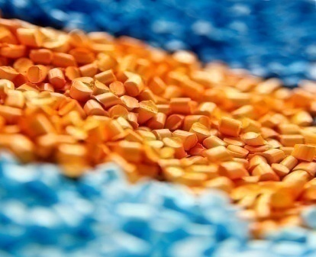


CHM 122 INTRODUCTORY ORGANIC CHEMISTRY (2 UNITS)
MODULE 12:
SYNTHETIC POLYMER

Slide 2
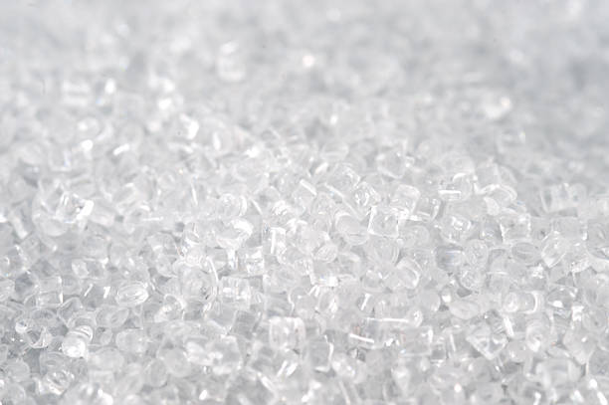
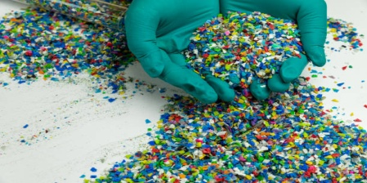
OBJECTIVES
To define some key terminologies of polymer chemistry.
To recognize the significance of polymer industry.
To highlight the effects of vulcanization on the natural rubber.
To distinguish between natural - and synthetic- polymer.
To identify structures of some few synthetic polymers.
To distinguish between addition- and condensation- polymer.

Slide 3
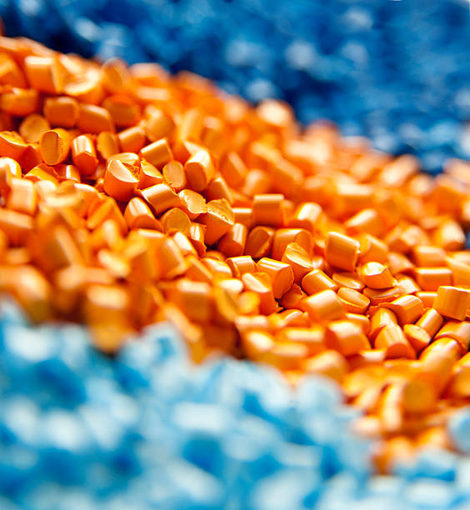
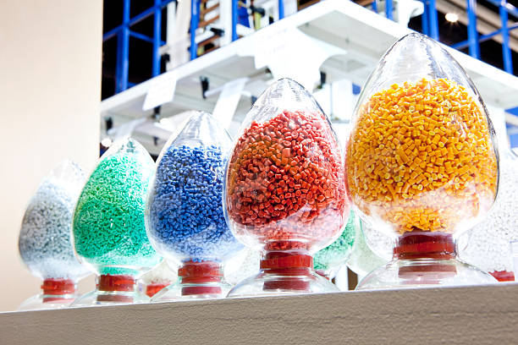
Keywords
Repeating unit = the recurring structural unit on a polymer chain structure.
Monomer = the building block of polymers which usually stands as the recurring unit (repeating unit).
Polymer = a giant molecule with heavy molecular weight, formed by the covalent linkages of thousands of small molecules called the monomers.
Covalent bonding = a strong form of bond existing in a molecule, which is formed between two atoms or groups through electron - sharing.

Slide 4
INTRODUCTION
The term polymer was invented in 1833 by Jons Jacob Berzelius. It was derived from two Greek words; “polys” meaning many and “meros” meaning parts. Thus, polymer in simple term means “many parts” or rather, “of many parts”.
A polymer is a large molecule that is made up of high molecular-weight chain of small molecules. The small molecules that are covalently linked together to form polymer are called the monomers.
These polymers are basically divided into two classes namely; natural and synthetic polymers.

Slide 5
Natural polymer: Natural polymers occur naturally as important biological molecules such as proteins, nucleic acids, and polysaccharides (starch and cellulose in wood and cotton). Natural rubber and natural fibers such as silk and wool also belong to the class of naturally occurring polymers.
Synthetic polymers: Most of the synthetic polymers are organic compounds. Familiar examples include plastics such as polyesters, Teflon, and Lucite (Plexiglass), and synthetic fibers such as nylon, Orlon, and Dacron.

Slide 6
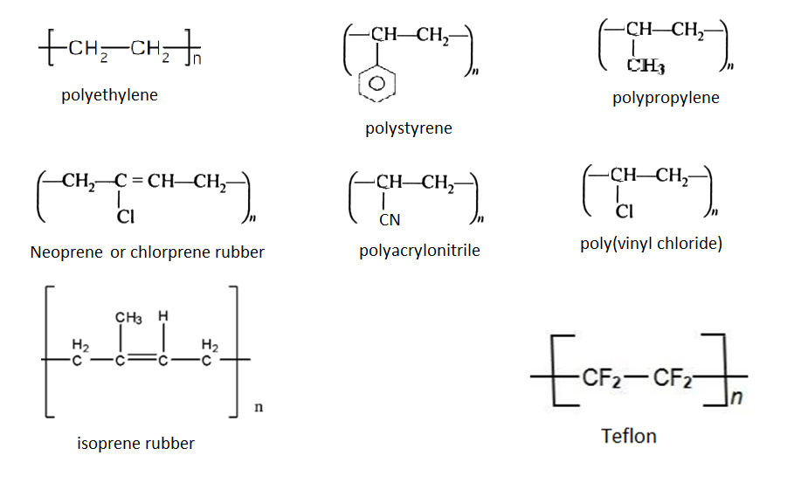
Structures of some Common Polymers

Slide 7
Polymerization
Polymerization is the combination of many small molecules (monomers) to form large molecules (polymers).
Basically, polymerization processes are classified into (i) addition reaction or polymerization and (ii) condensation reaction or polymerization.
Addition reactions or polymerization
Addition reactions involve unsaturated compounds containing double or triple bonds, particularly C=C and C≡C. The following processes describe simple addition reactions (a) hydrogenation of alkenes or alkynes (b) reaction of hydrogen halide with alkenes or alkynes (c) reaction of halogens with alkenes or alkynes.
Types of Polymerization

Slide 8
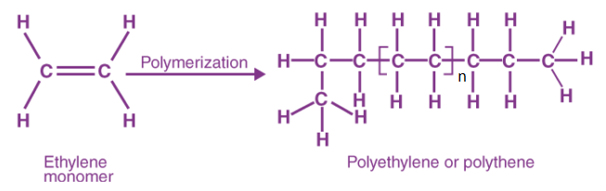

Addition polymerization is an important addition reaction of the alkenes and the polymers formed by this kind of reaction are called “addition polymers”. The formation of polyethylene is an important example of such processes.
Some of the Synthetically Produced Addition Polymers:
1-Polyethylene: in the presence of appropriate catalysts (a mixture of trialkyls, e.g. R₃Al, and titanium tetrachloride, TiCl₄), ethylene monomers polymerize into a chain containing about 800 or more carbon atoms.
The polymer can also be represented as CH₃-(CH₂-CH₂)_{n}-CH₃ , where n is approximately 400.

Slide 9
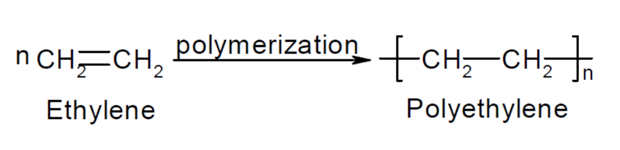
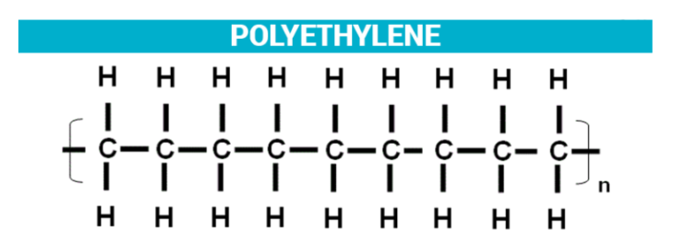

Slide 10
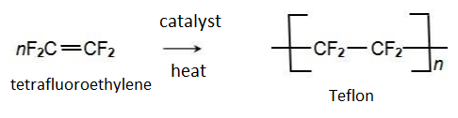
2-Teflon: polytetrafluoroethylene or Teflon is prepared from polymerization of tetrafluoroethylene.
The molecular weight of Teflon is about 2 x 10⁶. Approximately 20,000 tetrafluoroethylene units polymerize to form a giant molecule. Teflon is a very useful polymer which does not react with concentrated acids and bases or with most of the oxidizing agents. It does not dissolve in most organic solvents.

Slide 11
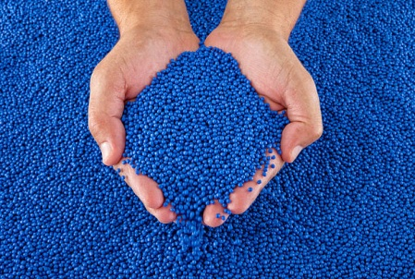
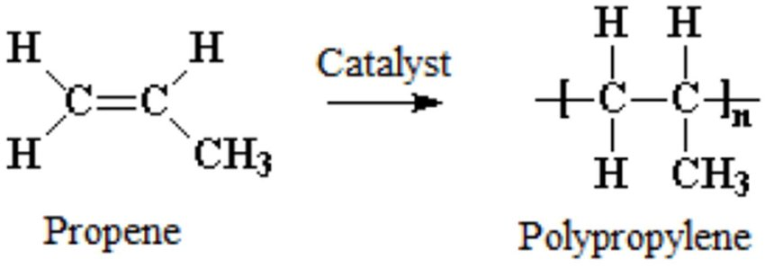
3- Polypropylene:
Polypropylene is formed from polymerization of propylene in a similar way to that of the previously mentioned process of ethylene transformation into polyethylene.
Polypropylene is a tough, flexible plastic widely used as an electrical insulator and for the fabrication of such items as unbreakable refrigerator dishes, plastic cups, and squeeze bottles.

Slide 12
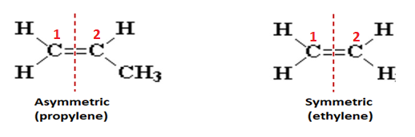
The chemistry of polymer is more complex if the starting units are asymmetric. Several geometrical isomers can result from addition of propene units. If the addition occurs randomly, atactic polypropylene which does not park together well is obtained.
These polymers are rubbery, amorphous, and relatively weak. Two others include an isotactic structure, in which all the R groups are arranged on the same side of the asymmetric carbon atoms, and a syndiotactic form, in which the R groups alternate on the left and right of the asymmetric carbons.

Slide 13
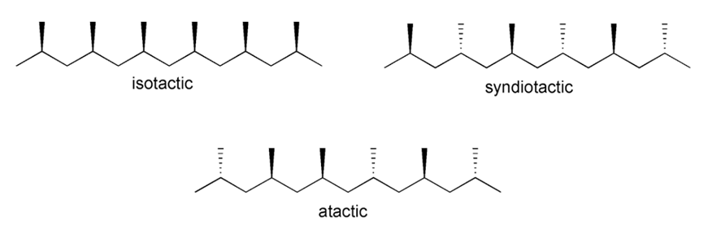
However, the isotactic isomer has the highest melting point and greatest crystallinity and is endowed with superior mechanical properties.

Slide 14
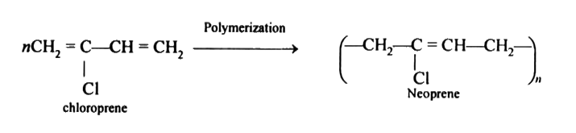
4- Neoprene: Some synthetic rubbers are superior to natural rubber in some ways. Neoprene is a synthetic elastomer (an elastic polymer) with properties quite similar to those of natural rubber.
The basic structural unit is 2-chloro-1,3-butadiene, commonly called chloroprene, which differs from isoprene by incorporating a chlorine atom rather than a methyl group at carbon 2 of the 1,3-butadiene chain.

Slide 15
Neoprene is less affected by gasoline and oil and is more elastic than natural rubber. It resists abrasion well and is not swollen or dissolved by hydrocarbons. It is widely used to make hoses for oil and gasoline, electrical insulation, and automotive and refrigerators’ parts.

Slide 16
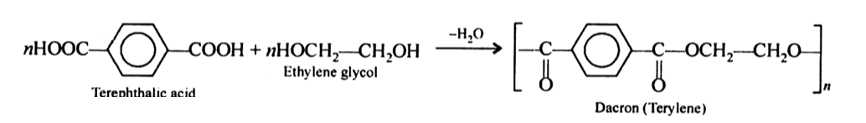
2. Condensation polymerization:
Some polymerization processes are based on condensation reactions, in which two molecules combine by splitting out or eliminating a small molecule.
For such a polymer to be formed, such monomer must have two reactive functional groups; one at each end. A polymer formed in this way is called a condensation polymer. There are many examples of condensation polymers based on a wide variety of bifunctional molecules.

Slide 17
Some of the Synthetically Produced Condensation Polymers:
1- Polyesters (short for “polymeric esters”): These are condensation polymers that are formed usually when dihydroxy alcohols react with dicarboxylic acids. An ester linkage is formed at each end of the monomer molecule to build up large molecules. A highly useful polyester (called Dacron) is prepared from the reaction between terephthalic acid and ethylene glycol.
Dacron: Dacron, a fiber produced as polyester, accounts for approximately 50 % of all synthetic fibers. It absorbs very little moisture, and its properties are nearly the same whether it is wet or dry.
Additionally, it possesses exceptional elastic recovery properties, so it is used to make “permanent-press” fabrics.

Slide 18
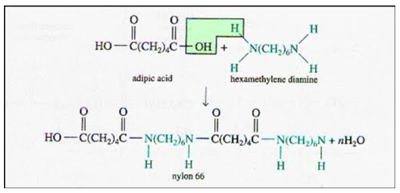
2- Nylons: Nylon is the best known polyamide. Polyamides are condensation polymers that contain amide functional group (CONH₂) and are usually prepared from reaction of a diamine and dicarboxylic acid.
Nylon 6,6
One of the most commonly known polyamide called nylon 6,6 is prepared by heating anhydrous hexamethylenediamine with anhydrous adipic acid; a dicarboxylic acid.
This substance is called nylon 6,6 because the parent diamine and dicarboxylic acid each contains six carbon atoms.

Slide 19
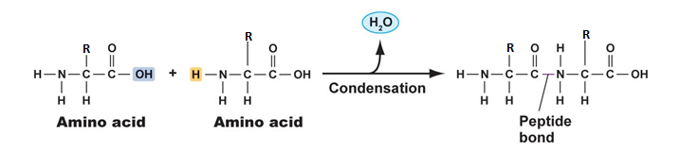
Natural Condensation Polymers:
Some naturally occurring condensation polymers such as proteins play crucial roles in living systems. Protein are polymeric chains of L-amino acids linked by peptide bonds.
A peptide bond is formed by the elimination of a molecule of water between amino group of one amino acid and the carboxylic group of another.
When this process is carried out repeatedly, a large molecule called a polypeptide is formed.

Slide 20
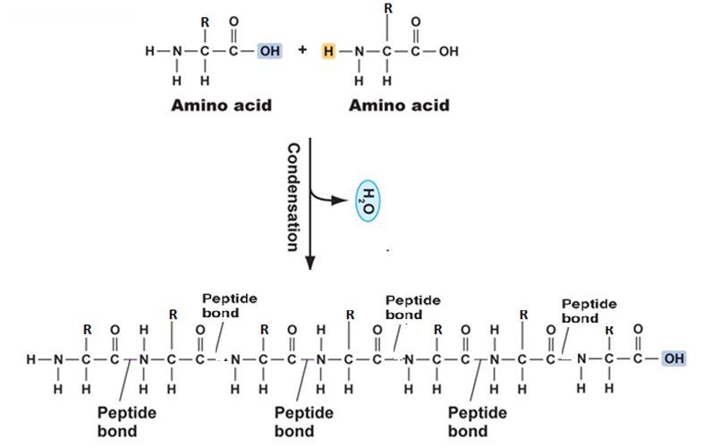

Slide 21
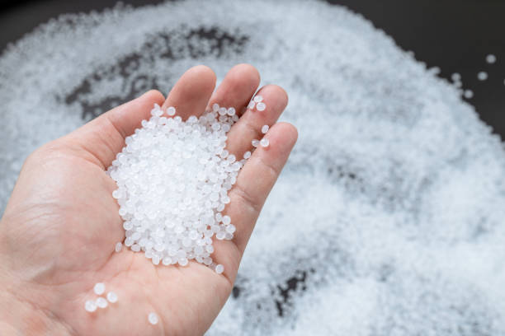
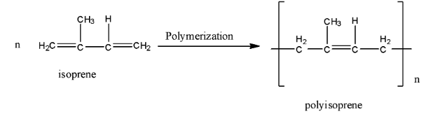
Vulcanization of Rubber
Natural rubber: Natural rubber is a naturally occurring polymer obtained from the sap of rubber tree; a sticky liquid called latex.
Rubber is a polymeric hydrocarbon formed in the sap by combination of about 2000 molecules of 2-methyl-1,3-butadiene, commonly called Isoprene. The molecular weight of rubber is about 136,000.
When natural rubber is warmed, it flows and becomes sticky. However, in order to eliminate this problem vulcanization is used.

Slide 22
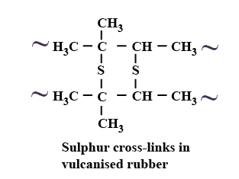
Vulcanization of rubber is the process in which sulfur is added to rubber and the mixture is heated to approximately 140 ºC.
Sulfur atoms add to some of the double bonds in the linear polymer molecules to form bridges that bind one rubber molecule to another. This cross-linking by sulfur atoms convert the linear polymer into a three dimensional polymer.

Slide 23
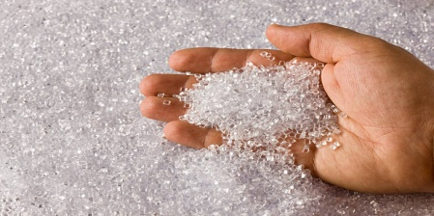
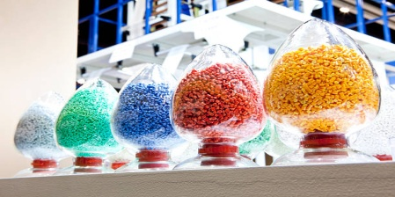
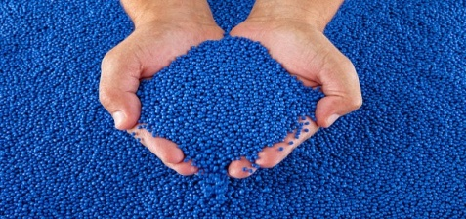

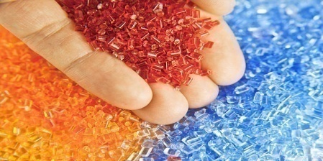
Some Raw Polymers
Fillers and reinforcing agents are added during the mixing process to increase the durability of rubber and to form colored rubber. Carbon black is the most common reinforcing agents whereas, zinc oxide, barium sulfate, titanium dioxide, and antimony sulfide are common fillers used.

Slide 24
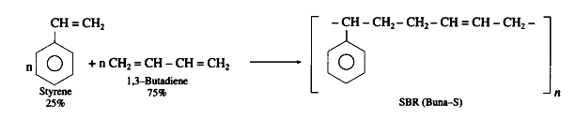
Copolymerization
When two different monomers are mixed and polymerized, copolymers are formed and the process is called copolymerization.
SBR is an example of copolymer called styrene butadiene rubber which is formed by the addition of butadiene to styrene in a 3:1 ratio. Styrene and butadiene are two different monomers. The double bond in SBR can be cross-linked by vulcanization as described in the case of natural rubber. SBR is used primarily for making tires.
Other copolymers are used in making car bumpers, body and classic parts, wire insulation, spotting goods, sealants; caulking compounds.

Slide 25
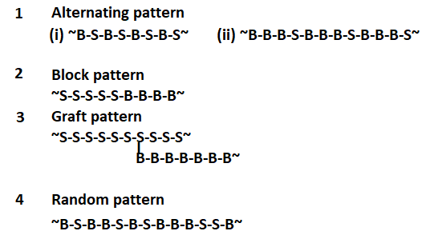
Depending on the ratio of two monomers and the reaction conditions, the order of the units can range from quite regular (e.g. alternating) to completely random. In this way, polymers with a wide variety of properties can be produced.

Slide 26
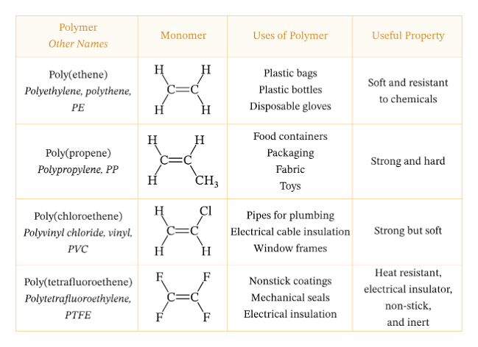
Summary of Applications

Slide 27
THANK YOU

